Slide 1

ILORIN INNOVATION HUB
TECHNICAL FIT-OUT DESIGN PROPOSAL

Slide 2
Office Design Proposal in Ilorin
The aim was to create a functional office able to impact upon wellbeing, motivation and productivity through the amplification of entrepreneurship. The design is characterized by a fluid gradual process from open offices to more private and enclosed workspaces, with zones that are task-specific and that encourage people to move, go for breaks, talk, have stand-up meetings etc. Furthermore, the aim was to establish an environment where people will prosper by achieving a sustainable design, aesthetically pleasing, with a good quality of the environment through an easy access to windows and to natural air ventilation, increasing health and wellbeing.
The internal layout form a cross where the minor axis constitute the entrance path while the major axis is the distributional one. On the right side a breakout area find place, serviced by a kitchen, bringing people together to eat, chat and meet, ideal for rest and creating intimate relationships, reinforcing the collegial and collaborative approach. At the left we find the workspace zone with an inermediate zone first characterized by movement and flexibility, allowing employees to seamlessly communicate, interact and collaborate (taking a drink, working on a laptop, taking notes while discussing relaxed with others etc.). Then we find an open office area where the cubicles are tearing down and where every person works individually but at the same time provides collaboration, interaction and team building possibilities. Finally, we have more private zones that offer complete privacy (for phone calls or focus work etc.).

Slide 3
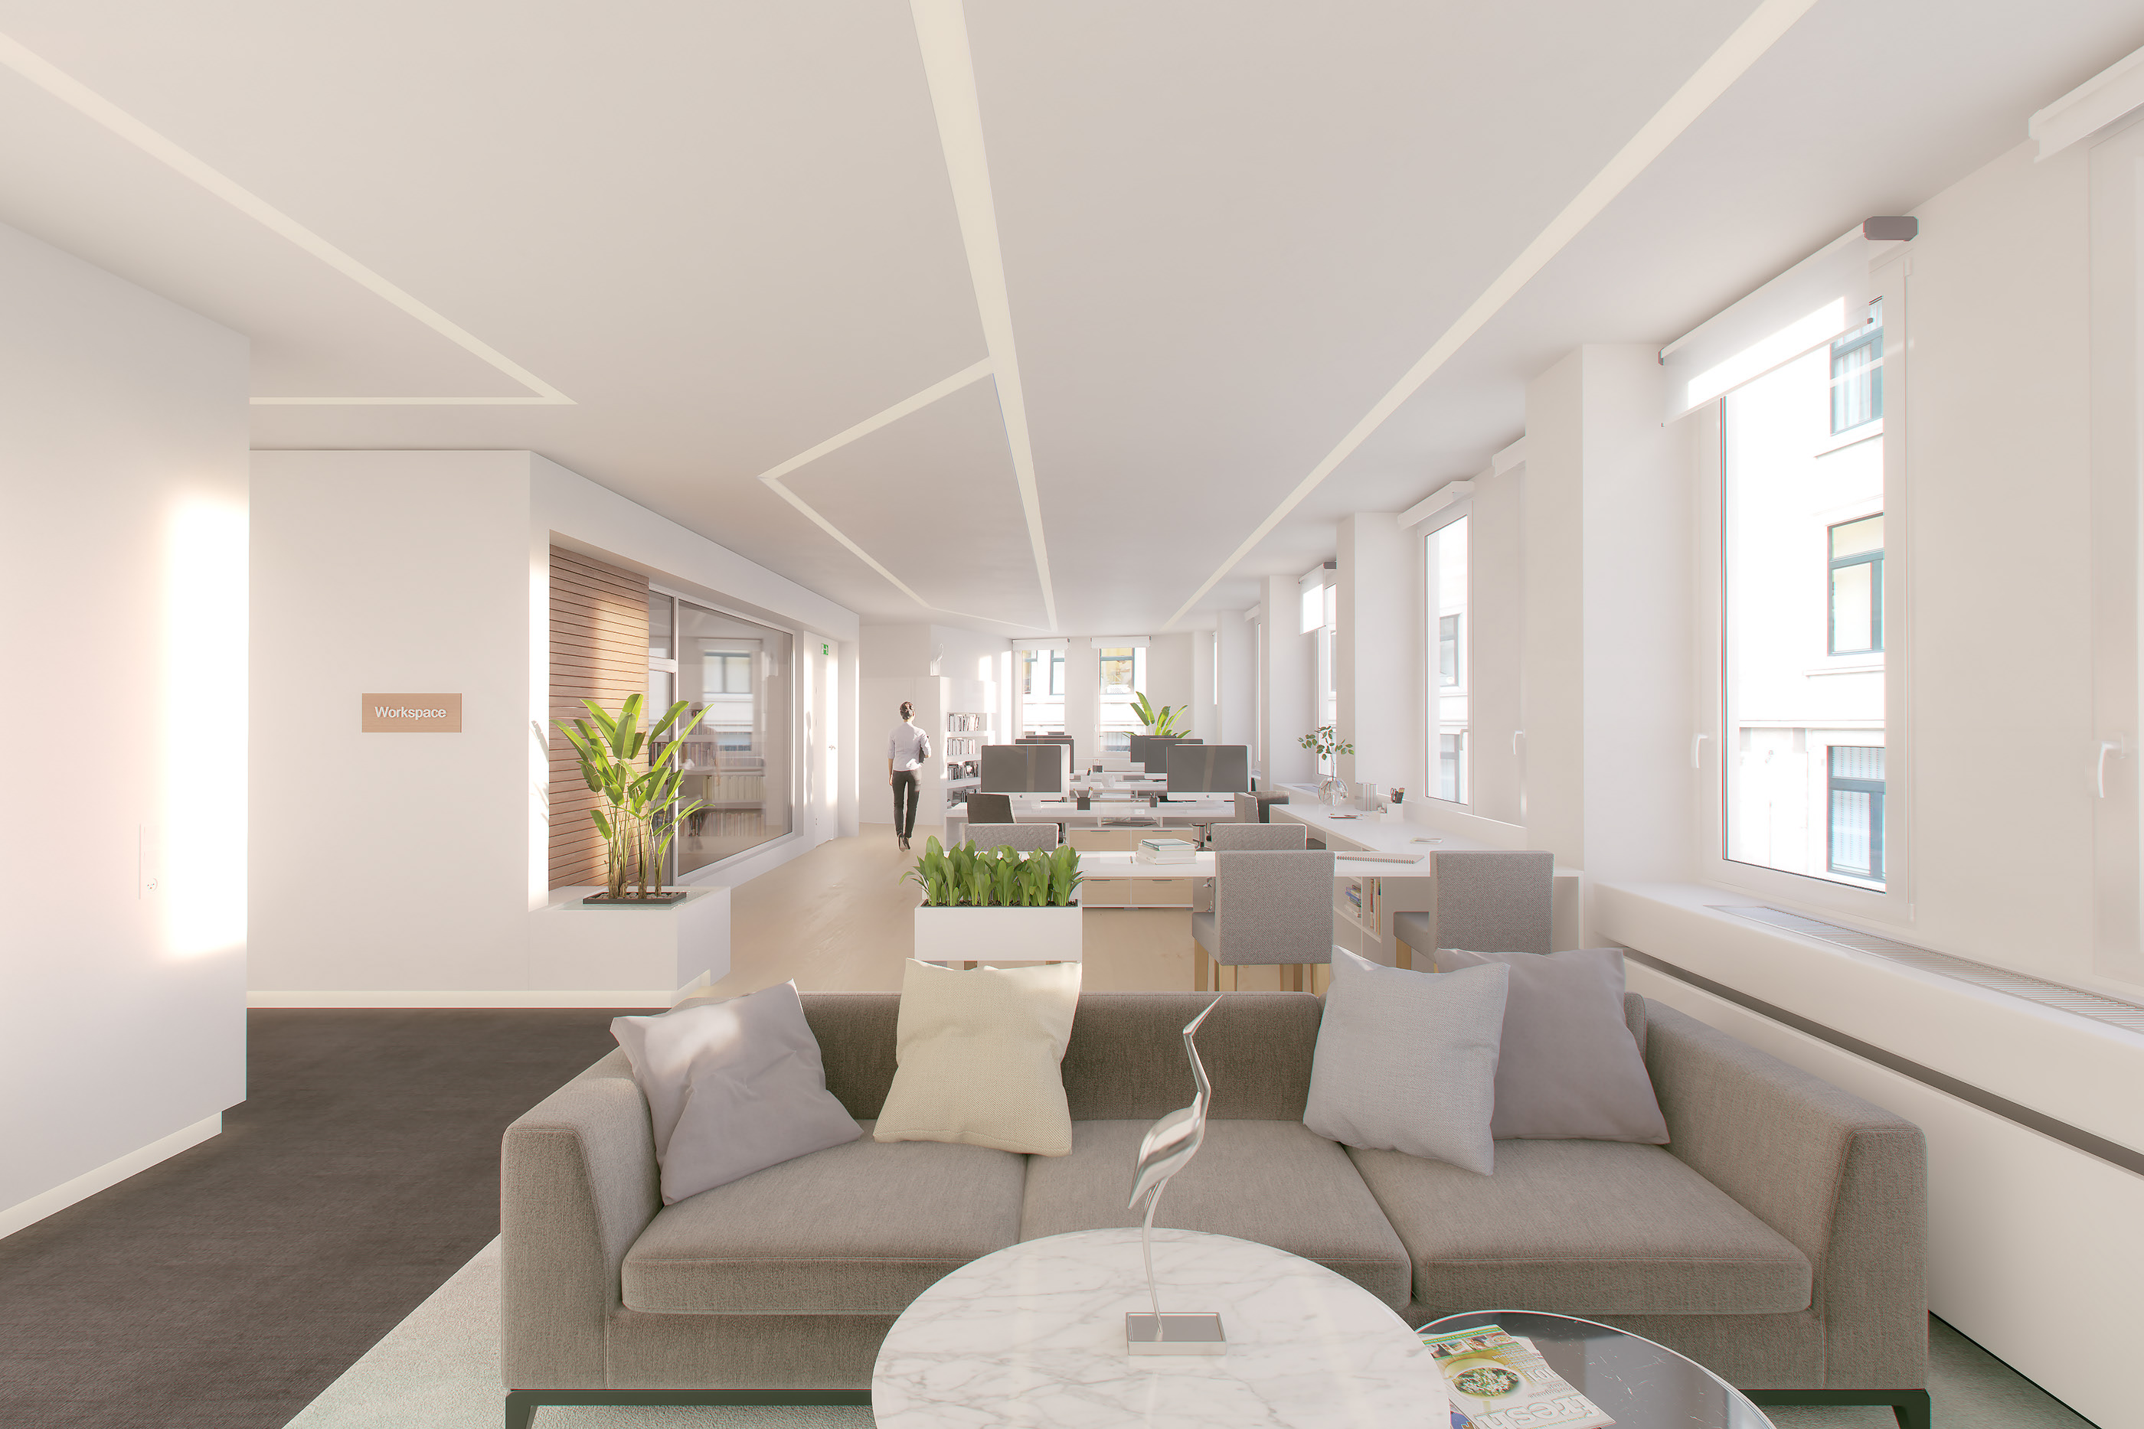

Slide 4
